Slide 1
Malaria Drugs
Spreadsheet Documentation

Slide 2
General Information
Link to spreadsheet: https://docs.google.com/a/binghamton.edu/spreadsheet/ccc?key=0Ag8gS12PpxX2dF82NS1CLVhwd1RDSjhiMnFpdGtUZVE&usp=drive_web#gid=20
Spreadsheet contains data regarding
Summary of company rankings
WHO groupings and country categorizations
The burden of Malaria and the data of its drugs by countries
The burden of TB and the data of its drugs by countries
The burden of HIV and the data of its drugs by countries.

Slide 3
Tab 1 Summary of Company Rankings
List of pharmaceutical companies, their drugs and target diseases
Ranking of the companies’ total impact scores:
Total impact scores = Need (DALYs lost) * Access (Treatment coverage) * Efficacy
Ranking of the companies break down by diseases
Total DALYs alleviated in different diseases break down by WHO regions

Slide 4
Tab 2 Country Data
Lists all countries and various ways countries are categorized:
Geographical region
UNAIDS region
UNICEF region
WHO region
World Bank Economy ranking

Slide 5
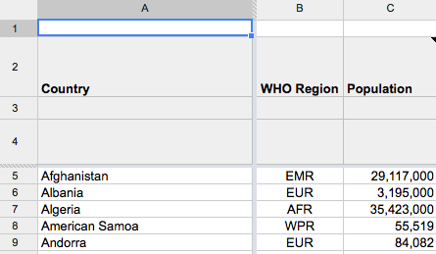
Tab3 Malaria by Countries
General information
Column A: List of countries
Column B: Countries sorted by WHO regions
Column C: Population

Slide 6
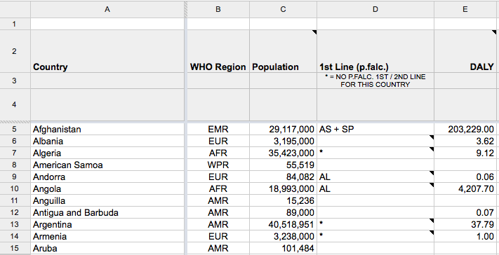
Tab 3 Malaria by Countries
Column D: Which first line drugs are used in the country for Plasmodium falciparum (p.falc) malaria
Column E: DALYs lost to TB break down by countries (2010 data)

Slide 7
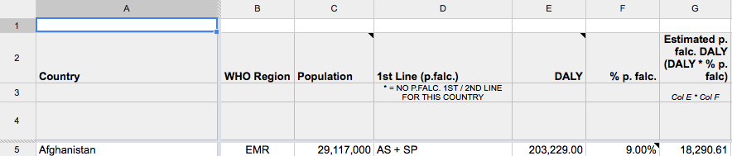
Calculating Needs
Column D: List of Countries using Plasmodium falciparum (p. falc.) malaria treatments and the name of their first/second line treatment drugs
Column F: % of p. falc. (WHO 2011 data)
Column G: Estimated need of p. falc. DALYs = DALYs lost (E) * % of p. falc. (F)
E * F = G

Slide 8
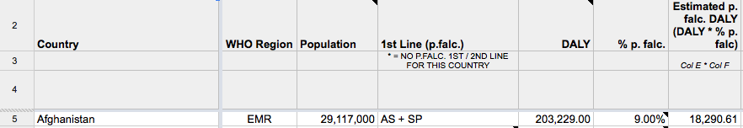
Example Calculating Needs in Afghanistan
Afghanistan (row 5) is using AS + AP to treat its p. falc. Malaria.
The DALYs lost to malaria in Afghanistan in 2010: 203,229.00
% of p. falc. = 9.00%
Estimated p. falc. DALYs lost to p. falc. Malaria in 2010 = 203,229.00 * 9% = 18,290.61
The Estimated Need of p. falc DALYs in Afghanistan: 18,290.61

Slide 9
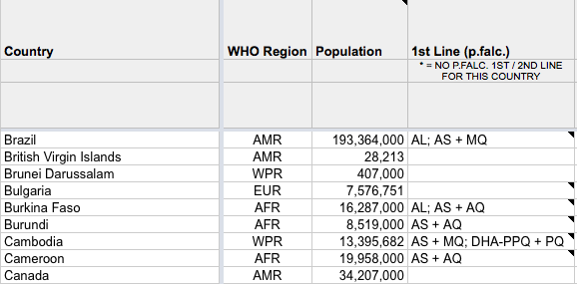
Calculating Needs II
If a country is using two (or more) p. falc. first or second line treatments, we divide the estimated p. falc. DALYs by two (or more) and assign the divided DALYs to each treatment

Slide 10
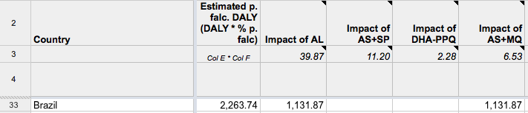
Example: Brazil
Brazil (row 33) is using both AL and AS + MQ to treat its p. falc. Malaria
DALYs lost to Malaria in Brazil in 2010: 15,091.60
% of p. falc: 15%
Estimated p. falc. DALYs = 15091.60 * 15% = 2,263.74
Estimated p. falc. DALYs of AL and AS+MQ = 2263.74/2 = 1,131.87
AL and AS+MQ each has 1,131.87 DALYs Estimated needs

Slide 11
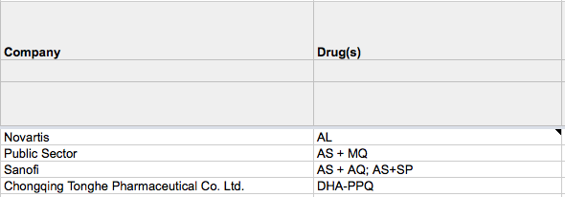
Calculating Needs
A company’s total score of needs = The sum of estimated needs of its malaria drug(s) in each country.

Slide 12
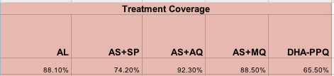
Calculating Access
Column W to AA: Treatment coverage break down by countries (WHO 2010 data)
If a country’s data of treatment coverage is unavailable, we use the average treatment coverage of the drug in all data available countries as our estimation.

Slide 13
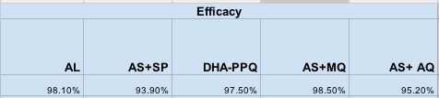
Calculating Efficacy
Column R to V: Efficacy break down by countries (WHO 2010 data)
If a country’s data of treatment efficacy is unavailable, we use the average treatment efficacy of the drug in all data available countries as our estimation.

Slide 14
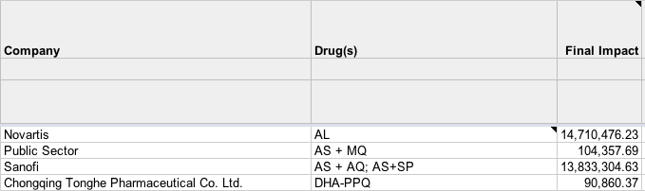
Impact Score by Companies
Column M & N / Row 5-8: Companies and their drugs
A company’s final impact score in Malaria = The sum of total DALYs need * treatment coverage * efficacy in each country

